Slide 1
CSE299
Final Presentation Guidelines

Slide 2
Final Presentation Guidelines
Final presentation is 15% of your final grade
This is a RECORDED presentation
You have to record your video at an earlier time
You will just play the video on the class
This is a GROUP presentation
ALL the members have to present
Presentation has to be 8-10 minutes
There will be 2 minutes Q/A after your presentation

Slide 3
Topics of the slides
Title slide – with Title of paper, Author names
Introduction & motivation [1-2 slides]
Literature survey [1-2 slides]
Methodology [5-7 slides]
Results and discussion [3-5 slides]
Conclusion and Future work [1-2 slides]
References (optional)
*** Slides numbers can vary

Slide 4
Introduction & motivation
Introduction: What you have done
Motivation: Why you have done. What is the objective/goal of your project.

Slide 5
Literature survey
Literature survey
Briefly describe some RECENT RELATED works

Slide 6
Methodology
Methodology
Describe your project here
Describe the flowchart
Describe all the features

Slide 7
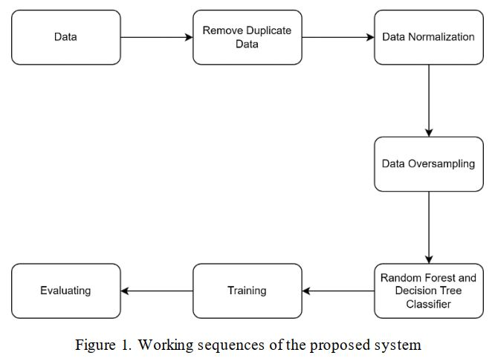

Slide 8
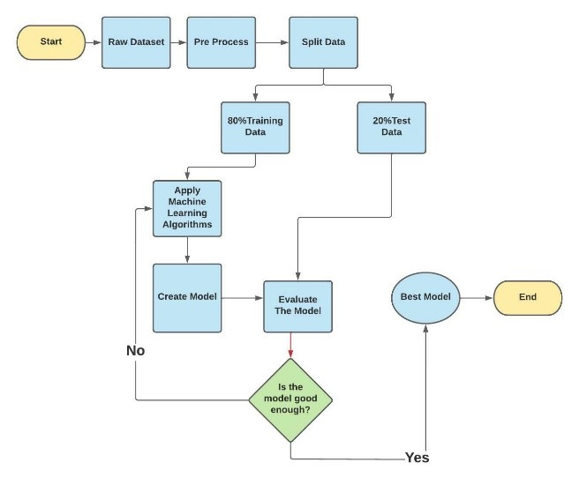

Slide 9
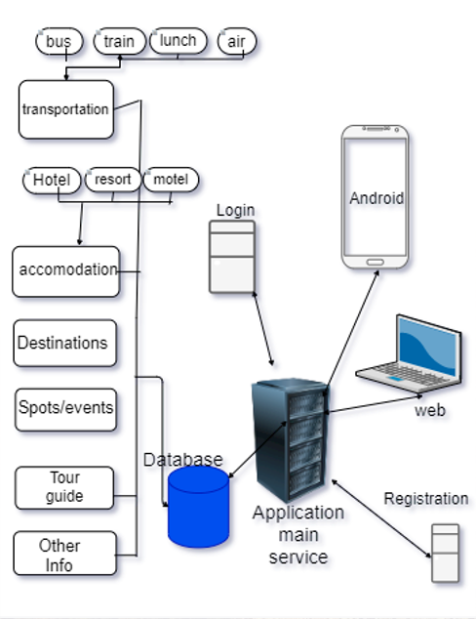

Slide 10
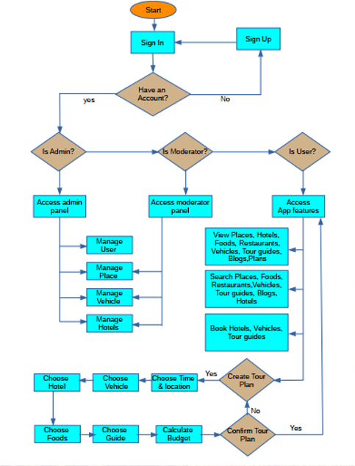

Slide 11
Results and discussion
Results and discussion
Discuss the results with figures

Slide 12
Conclusion and Future work
Conclusion and Future work
Tell about the future prospect
References (optional)

